Slide 1
COMPUTER NETWORKS SYLLABUS
UNIT I
Introduction: Uses of Computer Networks, Types of networks: WAN, LAN, MAN, Network Topologies, Reference models: OSI, TCP/IP.
Physical Layer: Transmission media: magnetic media, twisted pair, coaxial cable, fiber optics, wireless transmission.
UNIT II
Data link layer: Design issues in data link layer: framing, flow control, error control, Error Detection and Correction: Parity, CRC checksum, Hamming code, Flow Control: Sliding Window Protocols, Applications : Data link layer protocols HDLC, PPP.
UNIT III
Medium Access sub layer: Channel allocation problem, MAC Protocols: ALOHA, CSMA, CSMA/CD, MAC addresses, IEEE 802.X, Standard Ethernet, Wireless LANS. Bridges, Types of Bridges.

Slide 2
UNIT IV
Network Layer: Design issues in Network Layer, Virtual circuit and Datagram subnets-Routing algorithm: Shortest path routing, Flooding, distance vector routing, Link state routing, Hierarchical routing, Broad casting, Multi casting, Routing for mobile hosts.
Internetworking: Concatenated Virtual Circuits, Connectionless internetworking, Tunneling, Internetwork routing, Fragmentation.
UNIT V
Network layer in internet: IPv4, IP addresses, Sub netting, Super netting, NAT.
Internet control protocols: ICMP, ARP, RARP, DHCP, Network Layer in ATM Networks.
Congestion Control: Principles of Congestion, Congestion Prevention Policies.
Congestion Control in datagram Subnet: Choke packet, load shedding, jitter control.
Quality of Service: Leaky Bucket algorithm and token bucket algorithm.
UNIT VI
Transport Layer: Transport Services, Connection establishment, Connection release and TCP and UDP protocols.
Application Layer: Domain name system, FTP, HTTP, SMTP, WWW

Slide 3
TEXT BOOKS
1. Computer Networks — Andrew S Tanenbaum, 4th Edition. Pearson Education/PHI
2. Data Communications and Networking – Behrouz A. Forouzan.Third Edition TMH.
3.Data Communication and Netwoks- ,Bhushan Trivedi, Oxford Higher Education.
REFERENCES
1. An Engineering Approach to Computer Networks-S.Keshav, 2nd Edition, Pearson Education
2. Understanding communications and Networks, 3rd Edition, W.A. Shay, Thomson

Slide 4
Introduction
Chapter 1

Slide 5
What is Computer Network
A collection of Autonomous computers interconnected by any media.
Two computers are said to be interconnected if they are able to exchange information.
The connection may be via a copper wire/ fiber optics/microwaves/infrared/ satellites.

Slide 6
Why people are interested in Computer Networks
Resource sharing:
To make all physical resources such as printers, scanners, equipment, etc., available to anyone on the network without regard to the physical location of the resource and the user.
Information sharing:
Allowing users to access relevant information and documents, i.e data available to any one on the network instantly without regard to the location of the data and the user accessing it.

Slide 7
Uses of Computer Networks
  Business Applications
  Home Applications
  Mobile Users
  Social Issues

Slide 8
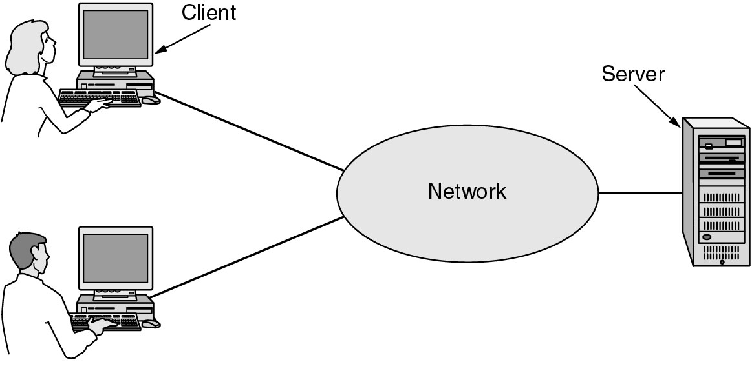
Business Applications of Networks
A network with two clients and one server.

Slide 9
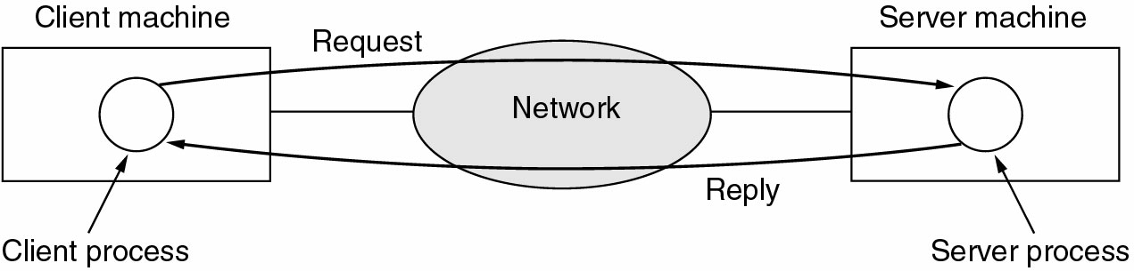
Business Applications of Networks (2)
The client-server model involves requests and replies.

Slide 10
Home Applications
Access to remote information
Person-to-person communication
Interactive entertainment
Electronic commerce

Slide 11
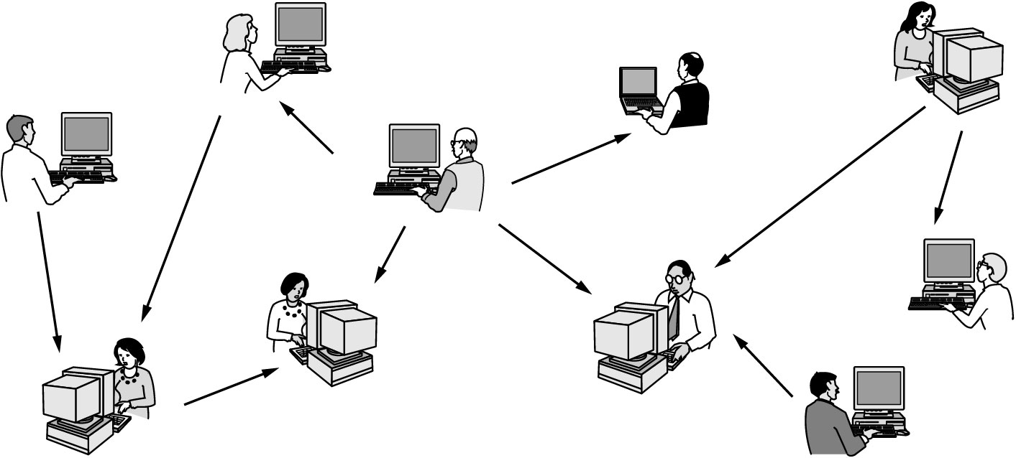
Home Applications (2)
In peer-to-peer system there are no fixed clients and servers.

Slide 12
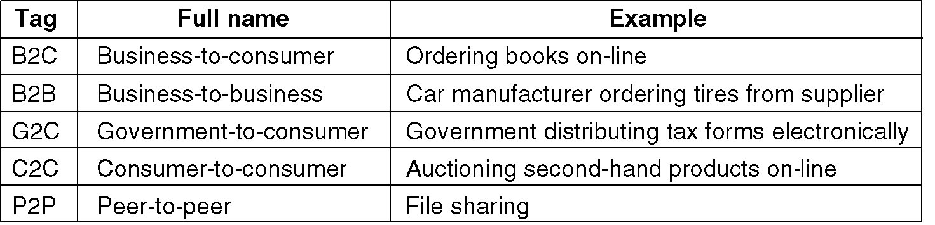
Home Applications (3)
Some forms of e-commerce.

Slide 13
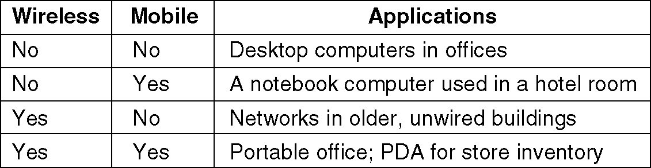
Mobile Users
Combinations of wireless networks and mobile computing.

Slide 14
Types of transmission technology
Broadcast links
Point-to-point links

Slide 15
Contd..
Broadcast networks have a single communication channel that is shared by all the machines on the network.
Short messages, called packets, sent by any machine are received by all the others. An address field within the packet specifies the intended recipient.
Broadcast systems allow possibility of addressing a packet to all destinations by using a special code in the address field.
Some broadcast systems support transmission to a subset of the machines, known as multicasting.
To indicate that it is multicasting one bit is reserved and remaining n-1 address bits can hold a group number.
In contrast, Point-to-Point networks consists of many connections between individual pairs of machines.
Point-to-Point transmission with one sender and one receiver is called Unicasting,

Slide 16
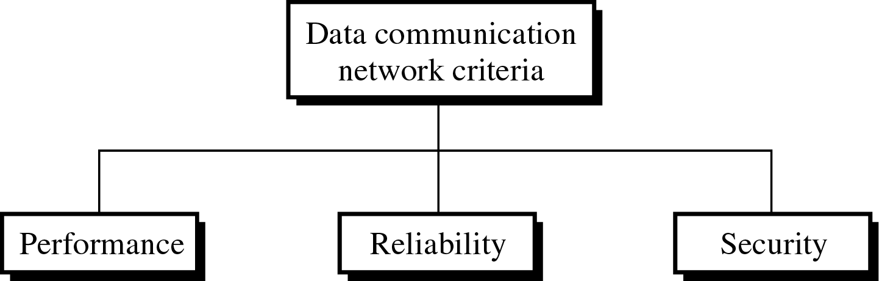
Network
Network: A set of devices (nodes) connected by communication links
Node: Computer, printer, or any device capable of sending and/or receiving data
To be considered effective and efficient, a network must meet a number of criteria
1-<number>

Slide 17

Type of Connection
1-<number>

Slide 18
Type of Connection
Point-to-point
  Dedicated link between two devices
  The entire capacity of the channel is reserved
  Ex) Microwave link, TV remote control
Multipoint
  More than two devices share a single link
  Capacity of the channel is either
    Spatially shared: Devices can use the link simultaneously
    Timeshare: Users take turns
1-<number>

Slide 19

Physical Topology
1-<number>

Slide 20

Mesh Topology
Dedicated point-to-point link to every other nodes
A mesh network with n nodes has n(n-1)/2 links. A node has n-1 I/O ports (links)
Advantages: No traffic problems, robust, security, easy fault identification & isolation
Disadvantages: Difficult installation/reconfiguration, space, cost
1-<number>

Slide 21

Star Topology
Dedicated point-to-point link only to a central controller, called a hub
Hub acts as an exchange: No direct traffic between devices
Advantages: Less expensive, robust
Disadvantages: dependency of the whole on one single point, the hub
1-<number>

Slide 22

Bus Topology
One long cable that links all nodes
tap, drop line, cable end
limit on the # of devices, distance between nodes
Advantages: Easy installation, cheap
Disadvantages: Difficult reconfiguration, no fault isolation, a fault or break in the bus stops all transmission
1-<number>

Slide 23

Ring Topology
Dedicated point-to-point link only with the two nodes on each sides
One direction, repeater
Advantages: Easy reconfiguration, fault isolation
Disadvantage: Unidirectional traffic, a break in the ring cab disable the entire network
1-<number>

Slide 24

Hybrid Topology
Example: Main star topology with each branch connecting several stations in a bus topology
To share the advantages from various topologies
1-<number>

Slide 25
Types of Network
Local Area Networks
Metropolitan Area Networks
Wide Area Networks

Slide 26
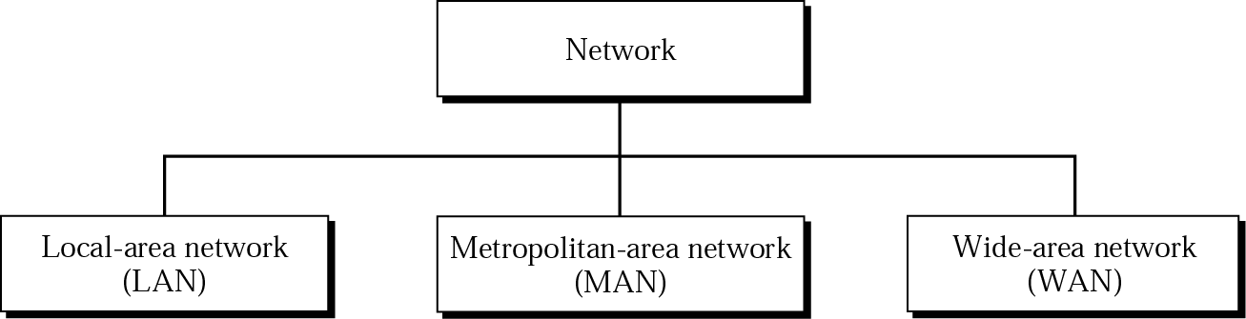
Categories of Networks
1-<number>

Slide 27
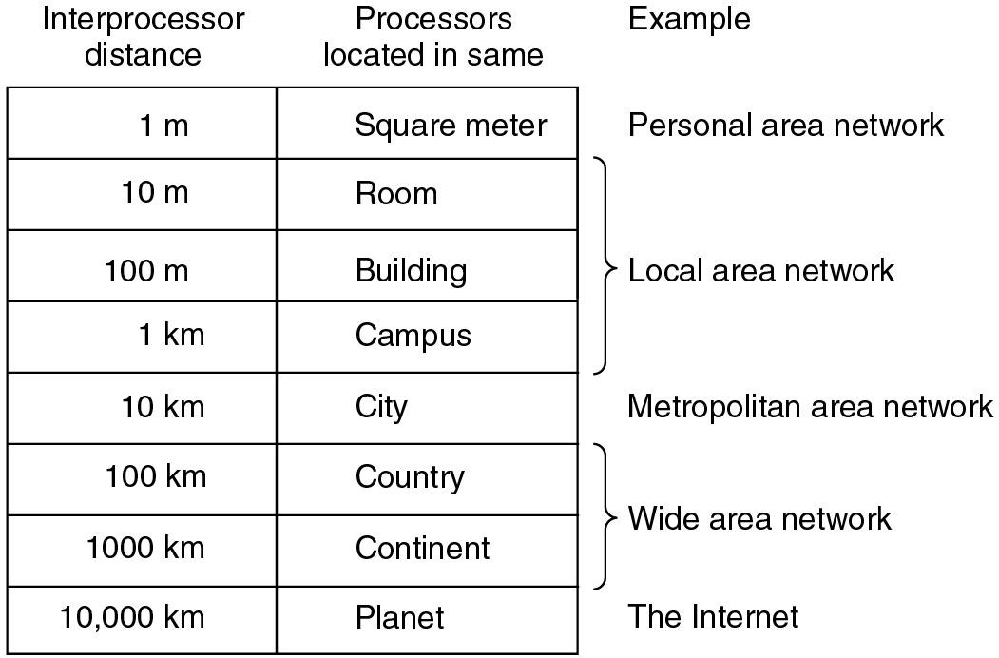
Classification of interconnected processors by scale

Slide 28

LAN (Local Area Networks)
Usually privately owned
A network for a single office, building, or campus ≤ a few Km
Common LAN topologies: bus, ring, star
An isolated LAN connecting 12 computers to a hub in a closet

Slide 29
LAN contd..
LANs, are privately-owned networks within a single building or campus of up to a few miles in size.
To connect personal computers and workstations in company offices and factories to share resources (e.g. printers) and exchange information.
LANs are distinguished from other kinds of networks by three characteristics: 1) their size, 2) their transmission technology, and 3) their topology.
Restricted in size
Use a transmission technology consisting of a single cable to which all the machines are attached, like the telephone company party lines once used in rural areas.
Traditional LANs run at speeds of 10 to 100 Mbps, have low delay (tens of microseconds), and make very few errors.

Slide 30
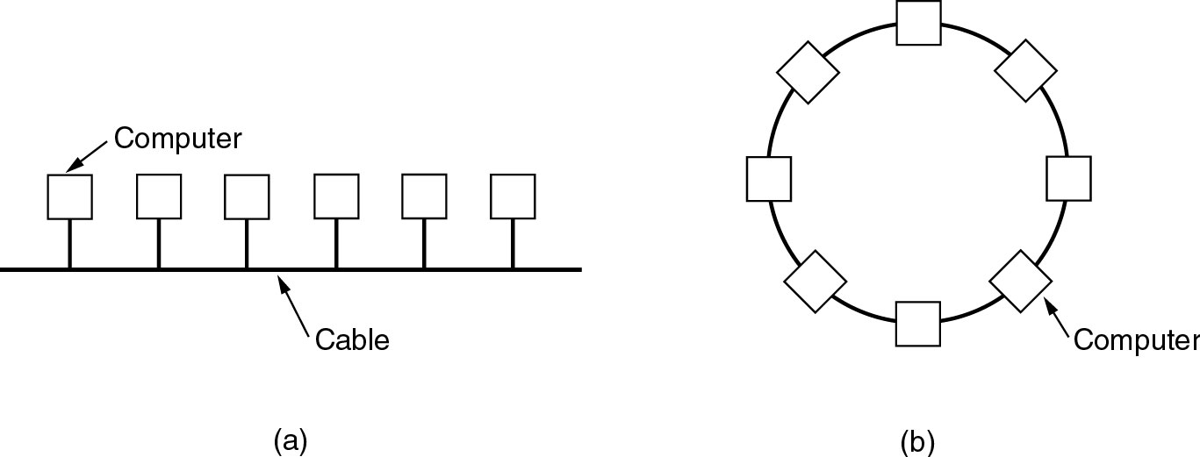
Local Area Networks
Two broadcast networks
(a) Bus
(b) Ring

Slide 31
Contd..
In a bus network, at any instant at most one machine is the master and is allowed to transmit. All other machines are required to refrain from sending.
An arbitration mechanism is needed to resolve conflicts when two or more machines want to transmit simultaneously. The arbitration mechanism can be centralizes or distributed.
IEEE 802.3, called Ethernet, is a bus-based broadcast network with decentralized control, usually operates at 10 Mbps to 10 Gbps.
The second type of broadcast system is the ring. In a ring, each bit propagates around on its own, not waiting for the rest of the packet to which it belongs.
IEEE 802.5( the IBM token ring), is a ring-based LAN operating at 4 and 16 Mbps. FDDI is another example of a ring network.

Slide 32
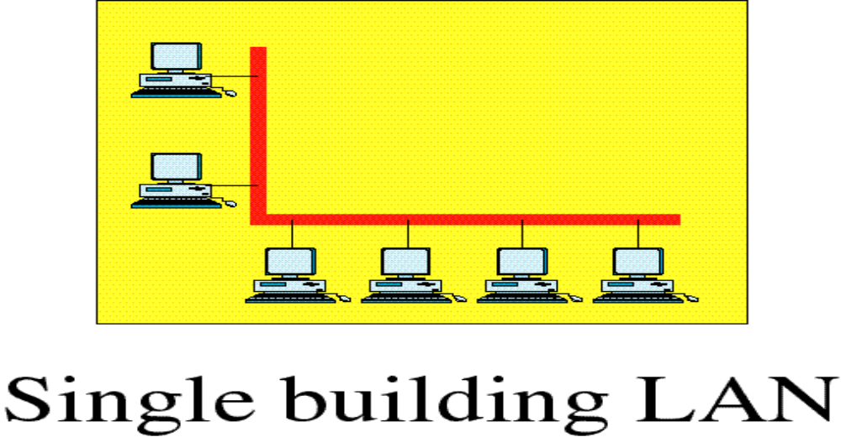
LAN (Local Area Networks)

Slide 33
Contd..
Broadcast systems can be further divided into static and dynamic , depending on how the channel is allocated.
A static allocation would be to divide time into discrete intervals and use a round-robin algorithm , allowing each machine to broadcast only when its time slot comes up. Static allocation wastes channel capacity when a machine has nothing to say during its allocated slot.
Dynamic allocation can be either centralized or decentralized.
In the centralized channel allocation, there is a single entity, for e.g. a bus arbitration unit, which determines who goes next.
In decentralized channel allocation method, there is no central entity; each machine must decide for itself whether to transmit.

Slide 34
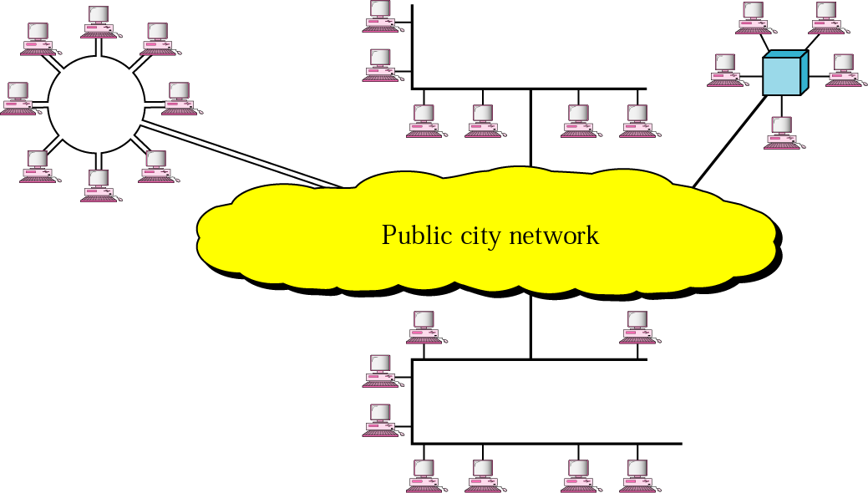
MAN (Metropolitan Area Networks)
Designed to extend to an entire city
Cable TV network, a company’s connected LANs
Owned by a private or a public company

Slide 35
MAN (contd…)
It is a bigger version of LAN
Ex: Local Cable Television Network.
It supports 802.6( IEEE standard) called DQDB (Distributed Queue Dual Bus)
DQDB consists of two unidirectional buses(cables) to which all computers are connected.
A metropolitan area network (MAN) is a network that interconnects users with computer resources in a geographic area or region larger than that covered by even a large local area network (LAN) but smaller than the area covered by a wide area network (WAN).
city-10km

Slide 36
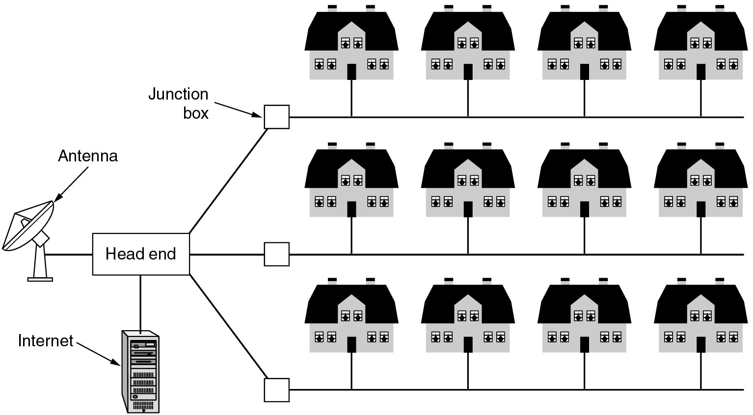
Metropolitan Area Networks
A metropolitan area network based on cable TV.

Slide 37

Wide Area Network(WAN)
Long distance transmission, e.g., a country, a continent, the world
Enterprise network: A WAN that is owned and used by one company

Slide 38
WAN contd…
Network spread geographically ( country or across globe) is called WAN.
WAN contain hosts these are connected by a communication subnet.
The job of the subnet is to carry messages from host to host.
Ex: The telephone system carries words from speaker to listener.
Relation between hosts and the subnet
Country : 100 km and 1,000 km

Slide 39
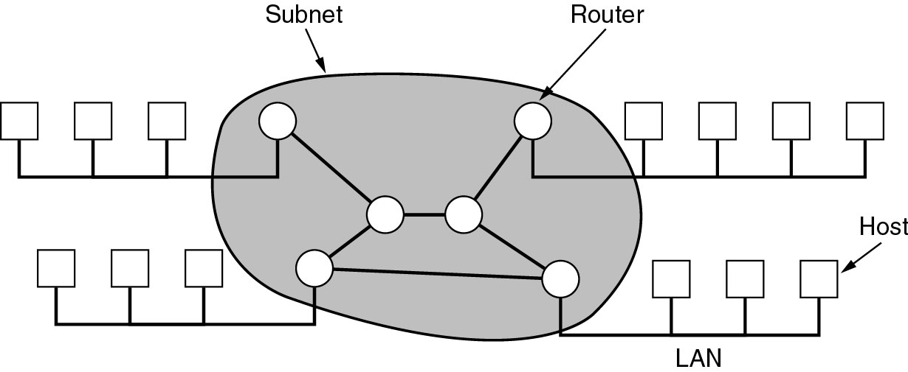
Subnet contains two distinct components
Transmission lines: ( trunks, circuits, or channels)
  move bits between machines.
Switching elements:
  Specialized computers used to connect two or more transmission lines.

Slide 40
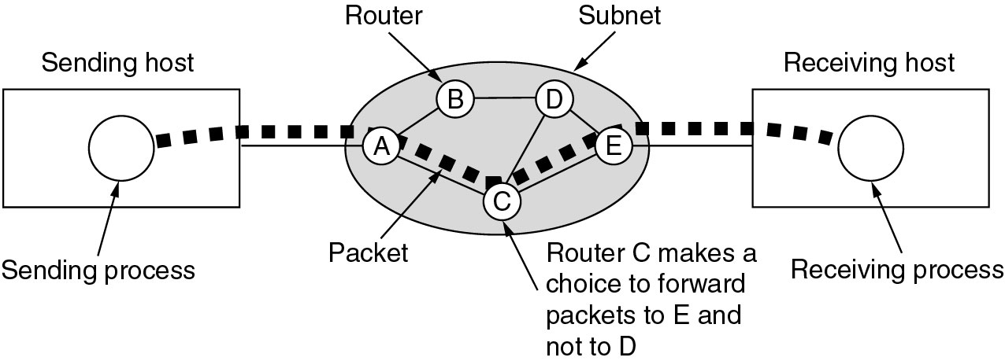
A stream of packets from sender to receiver
Point to point, store-and-forward, or packet-switched

Slide 41
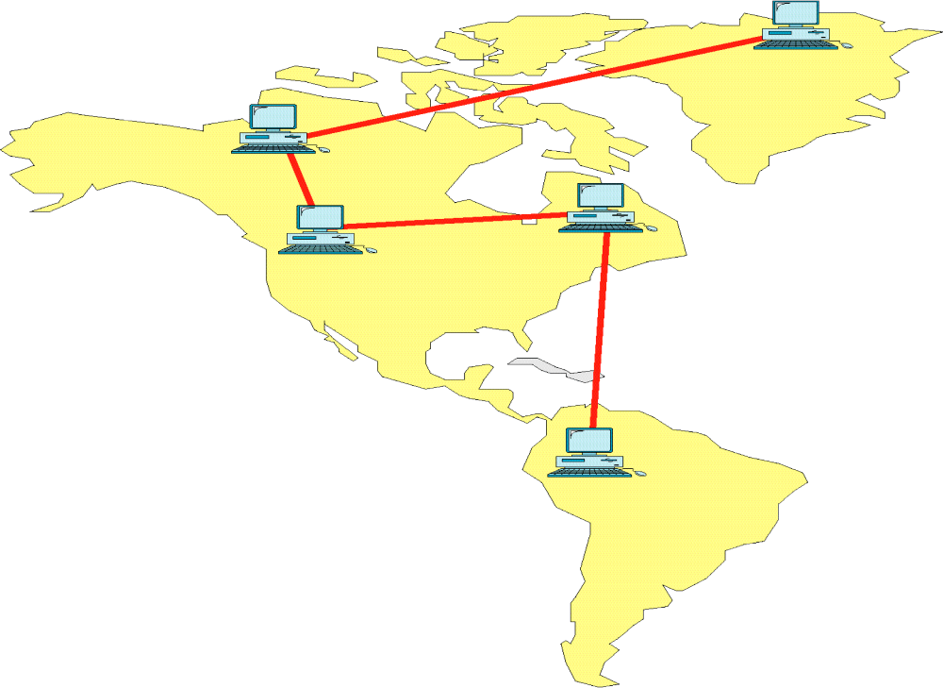
Wide Area Network

Slide 42
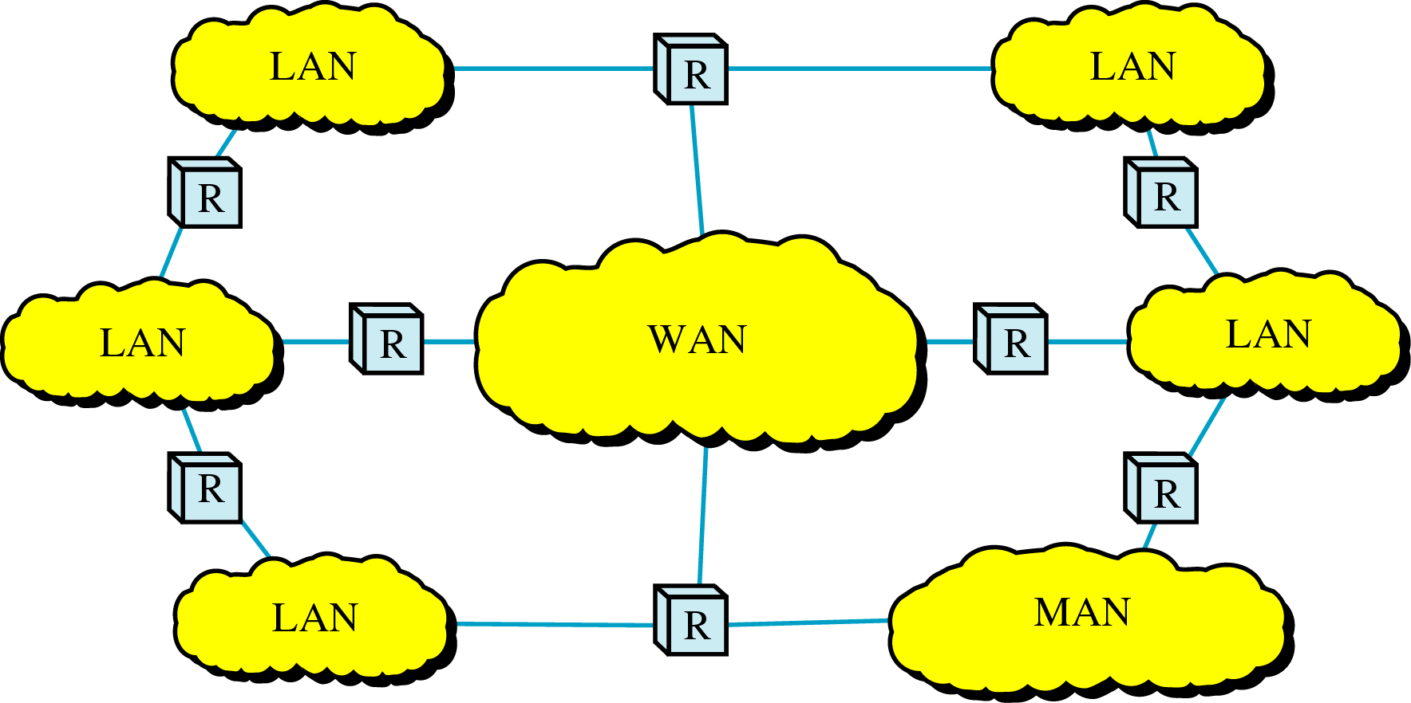
Internetwork
Internetwork (internet) : two or more networks are connected by internetworking devices
Internetworking devices: router, gateway, etc.
The Internet: a specific worldwide network
1-<number>

Slide 43

Internetwork Example
A heterogeneous network : four WANs and two LANs
1-<number>

Slide 44
Network Software
Protocol Hierarchies
Design Issues for the Layers
Connection-Oriented and Connectionless Services
Service Primitives
The Relationship of Services to Protocols

Slide 45
Protocol Hierarchies
To reduce the design complexity, most networks are organized as a stack of layers or levels, each one built upon the one below it.
The number of layers, name of the layers, function of the layers differ from one network to other.
Each Layer is to offer certain services to the higher layers.
Each layer shields the details of how the offered services to the higher layers

Slide 46
Technical words
Protocol : The rules and conventions used in the conversation between layer n on one machine to layer n on another machine are collectively known as the layer n protocol.
A Protocol is an agreement between the communicating parties on how communication is to proceed.
Peers: The entities comprising the corresponding layers on different machines are called peers.
Interface: Between each pair of adjacent layers is an interface. The interface defines which primitive operations and services the lower layer makes available to the upper one.
Network Architecture: A set of layers and protocols is called a network architecture.
Protocol stack: A list of protocols used by a certain system, one protocol per layer, is called a protocol stack.

Slide 47
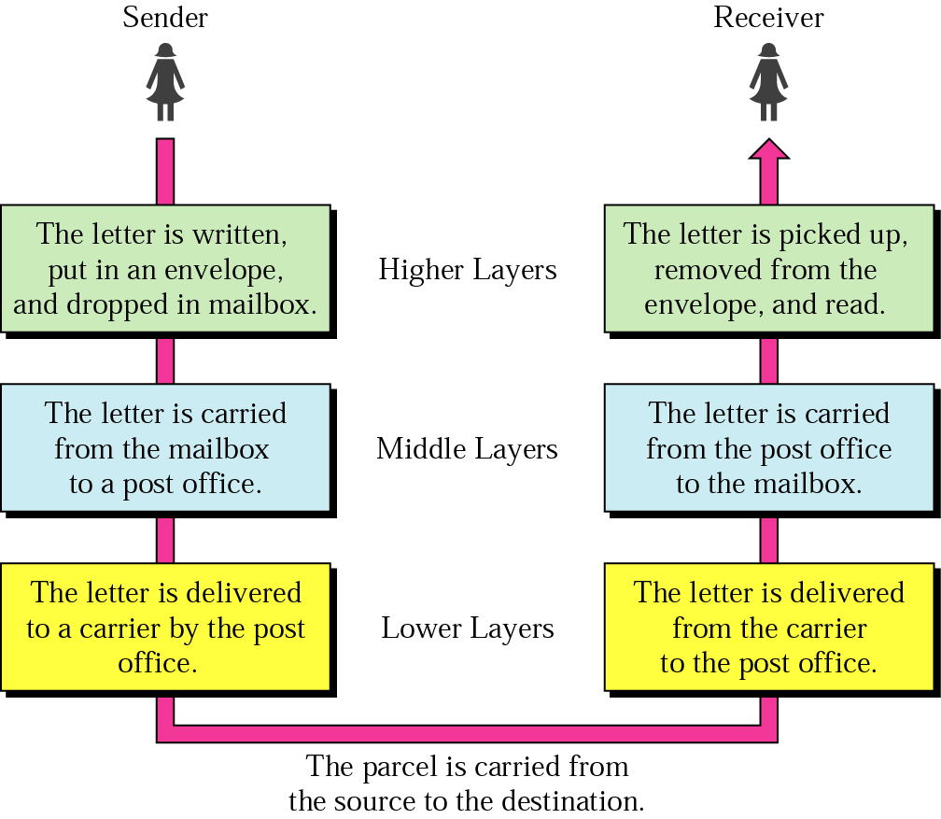
Layered Model: Sending a Letter
2-<number>

Slide 48
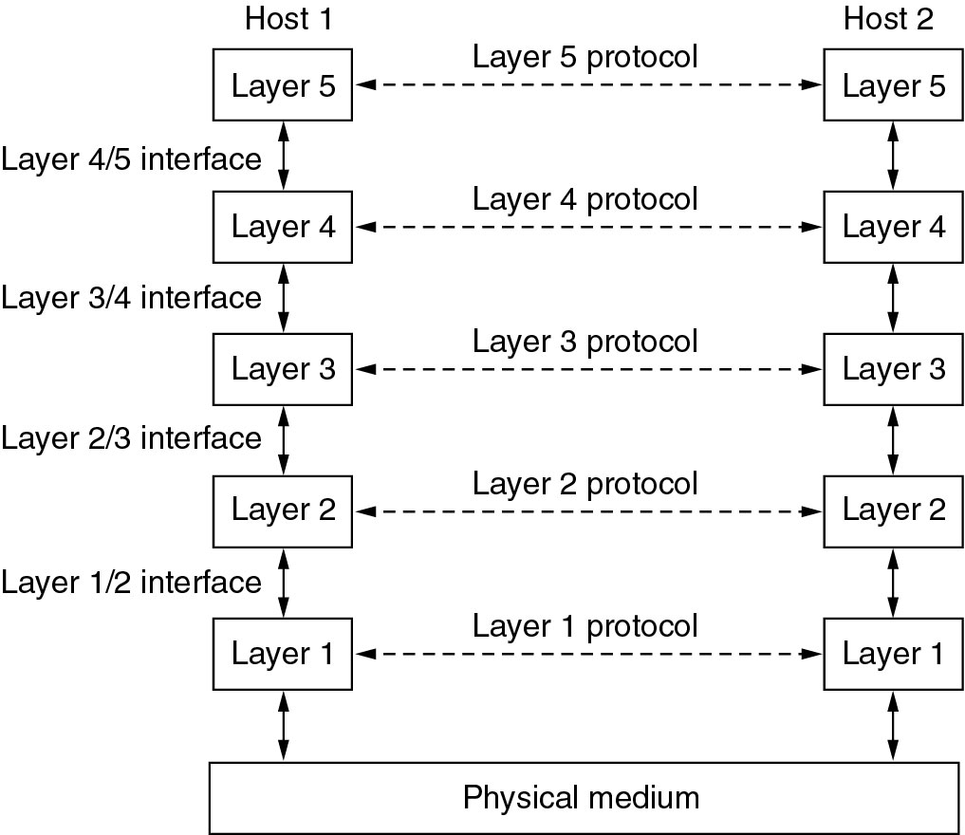
Network Software
Protocol Hierarchies
Layers, protocols, and interfaces.

Slide 49
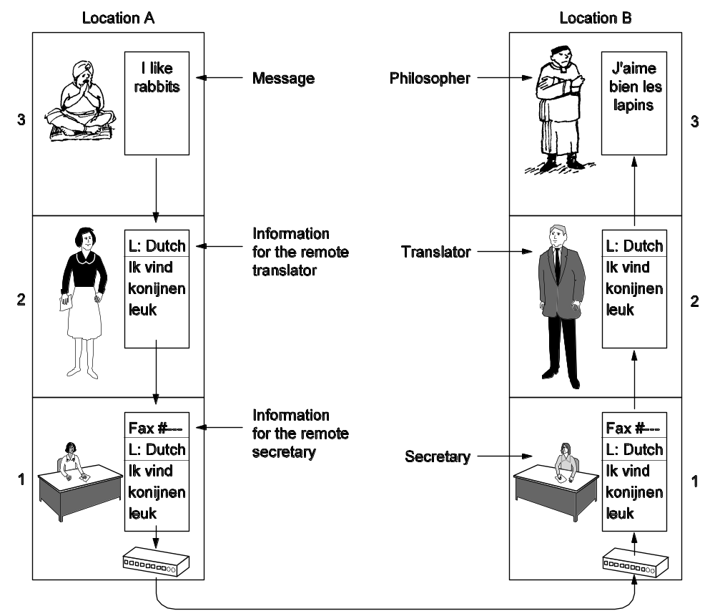
Protocol Hierarchies (2)
The philosopher-translator-secretary architecture.

Slide 50
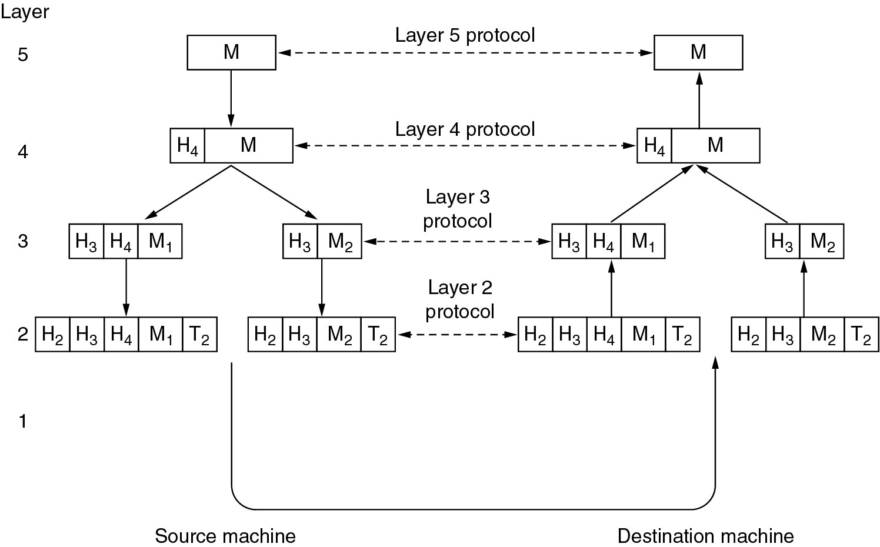
Protocol Hierarchies (3)
Example information flow supporting virtual communication in layer 5.

Slide 51
Design Issues for the Layers
Addressing
Rules for data transfer
Error Control
Flow Control
Disassembly and Reassembly
Multiplexing
Routing

Slide 52
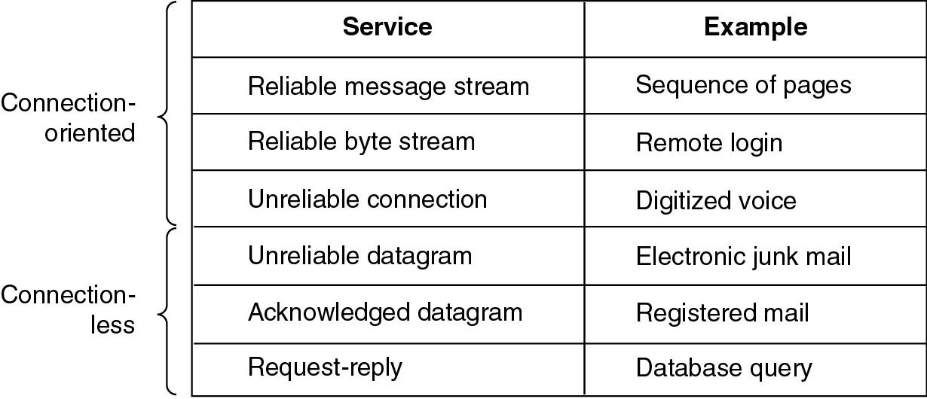
Connection-Oriented and Connectionless Services
Six different types of service.

Slide 53
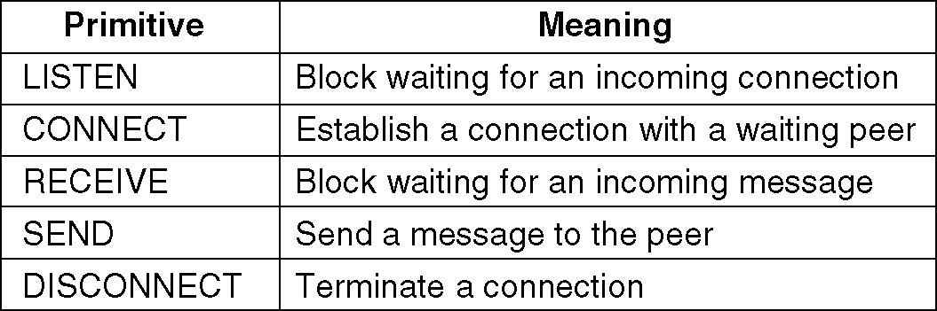
Service Primitives
A service is specified by a set of primitives(operations) available to a user process to access the service.
Five service primitives for implementing a simple connection-oriented service.

Slide 54
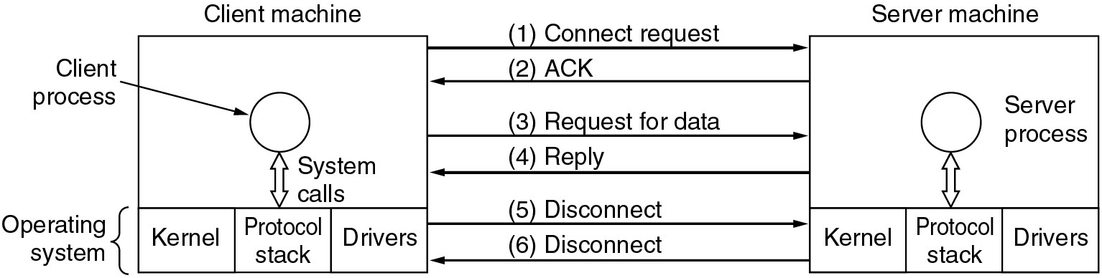
Service Primitives (2)
Packets sent in a simple client-server interaction on a connection-oriented network.

Slide 55
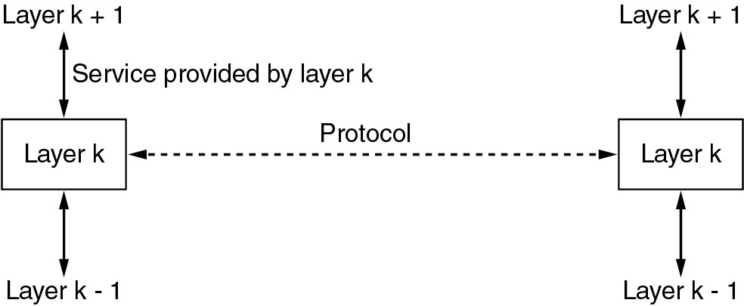
Services to Protocols Relationship
The relationship between a service and a protocol.

Slide 56
Reference Models
The OSI Reference Model
The TCP/IP Reference Model
A Comparison of OSI and TCP/IP
A Critique of the OSI Model and Protocols
A Critique of the TCP/IP Reference Model

Slide 57
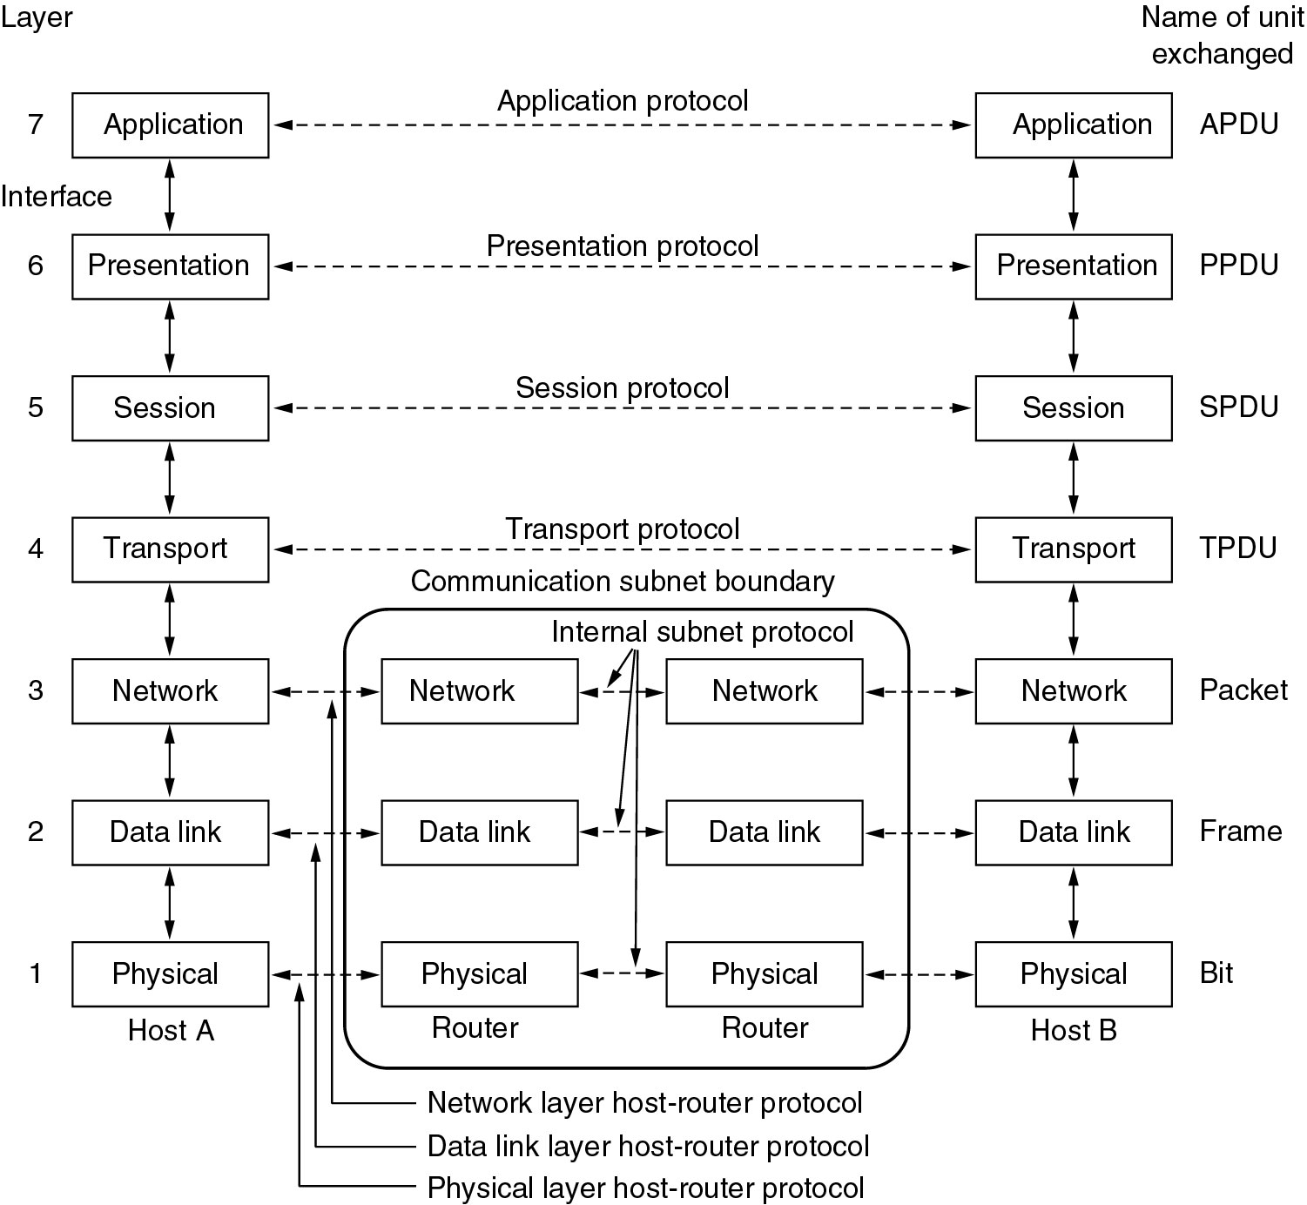
Reference Models
The OSI reference model.

Slide 58
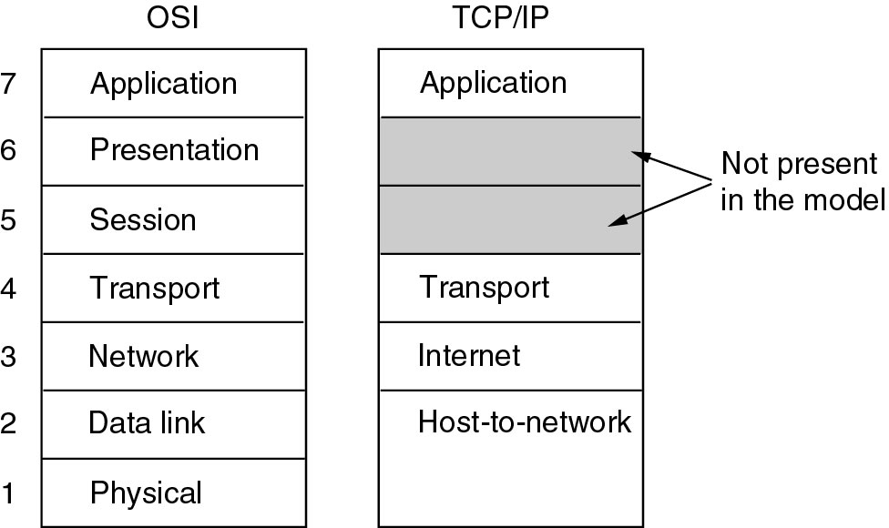
Reference Models (2)
The TCP/IP reference model.

Slide 59
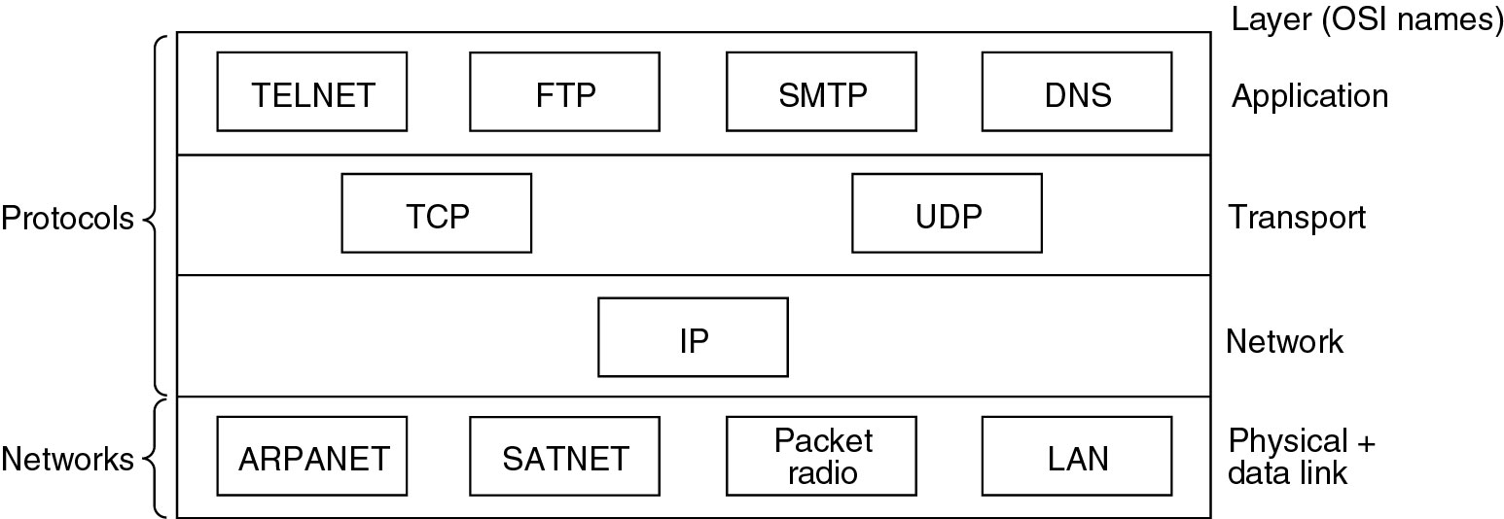
Reference Models (3)
Protocols and networks in the TCP/IP model initially.

Slide 60

OSI Model
ISO is the organization. OSI is the model
2-<number>

Slide 61

Interaction between layers in the OSI model
Layer and interface
2-<number>

Slide 62

An exchange using the OSI model
Encapsulation with header and possibly trailer
2-<number>

Slide 63

Physical Layer
The physical layer is responsible for movements of individual bits from one hop (node) to the next
Mechanical and electrical specification, the procedures and functions
2-<number>

Slide 64
Physical Layer: Duties
Physical characteristics of interfaces and media
Representation of bits
Data rate
Synchronization of bits
Line configuration
Physical topology
Transmission mode
2-<number>

Slide 65

Data Link Layer
The data link layer is responsible for moving frames from one hop (node) to the next
Transform the physical layer to a reliable (error-free) link
2-<number>

Slide 66
Data Link Layer: Duties
Framing
Physical addressing
Flow control
Error control
2-<number>

Slide 67

Hop-to-Hop Delivery
2-<number>

Slide 68

Network Layer
The network layer is responsible for the delivery of packets from the source host to the destination host
2-<number>

Slide 69

Network Layer: Duties
Logical addressing and routing
2-<number>

Slide 70

Transport Layer
The transport layer is responsible for delivery of a message from one process to another
2-<number>

Slide 71
Transport Layer: Duties
Service-point (port) addressing
Segmentation and reassembly
Connection control
Flow control
Error control
2-<number>

Slide 72

Reliable Process-to-Process Delivery of a Message
2-<number>

Slide 73

Session Layer
Session layer is responsible for dialog control and synchronization
2-<number>

Slide 74

Presentation Layer
Presentation layer is responsible for translation, compression, and encryption
2-<number>

Slide 75

Application Layer
Application layer is responsible for providing services to the user
2-<number>

Slide 76
Application Layer: Services
Network virtual terminal: It allows a user to log on to a remote host.
Mail services
File transfer, access, and management
Directory services: provides distributed database sources and access for global information about various objects and services.
2-<number>

Slide 77

Summary of Layers
2-<number>

Slide 78

TCP/IP and OSI Model
2-<number>

Slide 79
TCP/IP Protocol Suite
Host-to-network : Physical and data link layer
  No specific protocol
Network layer
  IP(Internet Protocl), ARP(Address Resolution Protocol), RARP(Reverse ARP), ICMP(Internet Control Message Protocol), IGMP(Internet Group Message Protocol)
Transport layer
  TCP(Transmission Control Protocol), UDP(User Datagram Protocl), SCTP(Stream Control Transmission Protocol),
Application Layer
  Combined session, presentation, and application layers
2-<number>

Slide 80

Addressing
Four levels of addresses in TCP/IP protocols
Physical (link), logical (IP, network), port, and specific addresses
2-<number>

Slide 81

Relationship of Layers and Addresses
2-<number>

Slide 82

Physical Address
A node with physical address 10 sends a frame to a node with physical address 87. The two nodes are connected by a link (bus topology LAN). As the figure shows, the computer with physical address 10 is the sender, and the computer with physical address 87 is the receiver.
07:01:02:01:2C:4B
A 6-byte (12 hexadecimal digits) physical address.
2-<number>

Slide 83

Logical (IP) Address
The physical addresses will change from hop to hop, but the logical addresses usually remain the same
2-<number>

Slide 84

Port Address
The physical addresses change from hop to hop, but the logical and port addresses usually remain the same
2-<number>

Slide 85
Specific Address
Some application have user-friendly addresses that are designed for that specific address
Example 1: e-mail address: kchung@kw.ac.kr
  Defines the recipient of an e-mail
Example 2: URL (Universal Resource Locator, now it is renamed as Uniform Resource Locator) : www.kbs.co.kr
  Used to find a document on the WWW
2-<number>

Slide 86
The physical layer

Slide 87
Physical Layer
The purpose of the physical layer is to transmit a raw bit stream from one machine to another.
Various physical media can be used for the actual transmission.
Transmission Media:
Media are grouped into guided media and unguided media.
Guided media means waves are guided along solid medium.
Ex: copper wire, fiber optics.
Unguided media is a media doesn't use any physical connectors between the two devices communicating. Usually the transmission is send through the atmosphere.
Ex: radio waves, micro waves, Infrared waves

Slide 88

The physical layer and transmission Medium

Slide 89

Classes of transmission media

Slide 90
Guided Transmission Data
  Twisted Pair
  Coaxial Cable
  Fiber Optics

Slide 91
Twisted Pair
Oldest transmission media
A twisted pair consists of two insulated copper wires typically about 1mm thick. The wires are twisted together in a helical form.
Twisting reduces interference (two parallel wires constitute a simple antenna; a twisted pair does not.)
Cheap medium
Commonly used for communications within buildings and in telephone networks
For longer distance repeaters are needed.
Twisted pairs can be used for transmitting either analog or digital signals.
Produced in unshielded (UTP) and shielded (STP) forms, and in different performance categories.
Cables may hold hundreds of pairs. Neighbor pairs typically have different twist lengths to reduce crosstalk.

Slide 92
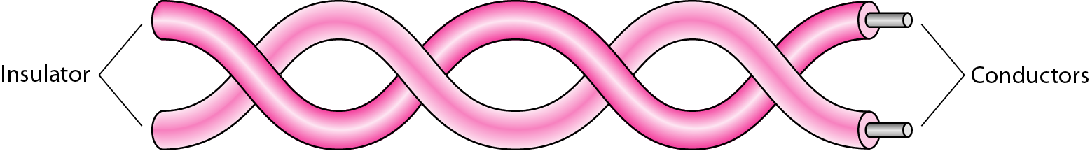
Twisted-pair cable

Slide 93
Twisted Pair
(a) Category 3 UTP.
(b) Category 5 UTP.

Slide 94

UTP and STP cables

Slide 95
Coaxial Cable
Pair of conductors separated by insulation
It has better shielding than twisted pair
Offers longer distances and better speeds than twisted pair, due to better shielding.
Used for cable TV and local-area networks. Had been widely used in telephone systems, but optical fiber is now assuming this task.
Baseband Coaxial Cable 50-ohm cable, commonly used for digital transmission. Broadband Coaxial Cable 75-ohm cable, commonly used for analog transmission.
A coaxial cable consists of a stiff copper wire as the core, surrounded by an insulating material. The insulator is encased by a cylindrical conductor, often as a closely woven braided mesh. The outer conductor is covered in a protective plastic sheath.
Good combination of high bandwidth and excellent noise immunity.
It is widely used for cable television and metropolitan networks.

Slide 96

Coaxial cable

Slide 97

Categories of coaxial cables

Slide 98
Fiber Optics
Optical Fiber
Three key components: light source, transmission system, and a detector
The detector generates an electric pulse when hit by light
1-a pulse of light; 0-missing pulse of light.
optical rays travel in ultra-thin fiber of glass
By attaching a light source to one end of an optical fiber and a detector to the other, we have a unidirectional data transmission system
accepts an electrical signal converts to light at sending side transmits light pulses and then reconverts the light pulses to an electrical signal at the receiving end.
A light ray incident at or above the critical angle is trapped inside the fiber.

Slide 99

Bending of light ray

Slide 100

Optical fiber

Slide 101
Fiber optic cable
Fiber optic cables are similar to coax, except without the braid.
At the center is the glass core through which the light propagates.
Multimode fiber, the core is typically 50 microns
Single mode fiber, the core is 8 to 10 microns.
The core is surrounded by a glass cladding, to keep all the light in the core.
Next comes a thin plastic jacket to protect the cladding.
Fibers are typically grouped in bundles, protected by an outer sheath.
Fibers can be connected in three different ways.
1. plugged in to fiber Sockets.
2. Mechanical splices: clamp the two ends of fiber
3. fusion splice: two pieces of fiber can be fused(melted) to form a solid connection

Slide 102
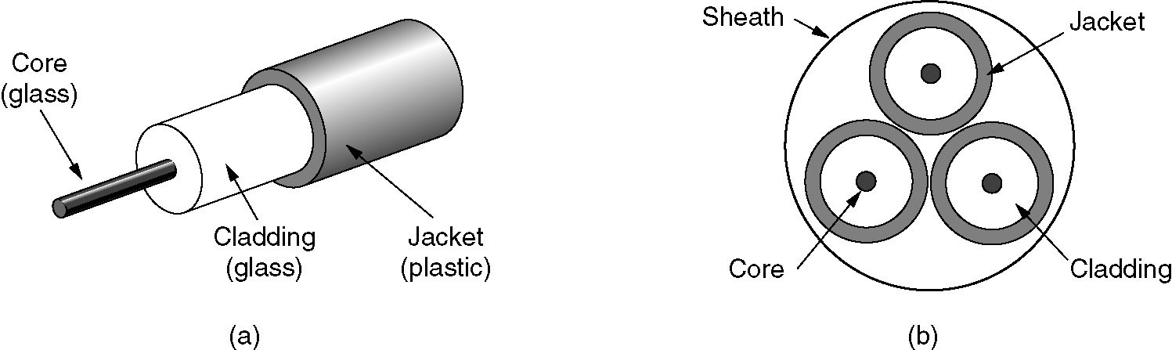
Fiber Cables
(a) Side view of a single fiber.
(b) End view of a sheath with three fibers.

Slide 103
Fiber Optics contd..
Many different rays will be bouncing internally around at different angles. Each ray is said to have a different mode, so a fiber having this property is called a multimode fiber.
If the fiber’s diameter is reduced to a few wavelengths of light, the light can propagate only in a straight line, without bouncing, this property is called a single mode fiber.
Single mode fiber are more expensive but are widely used for longer distances.Transmit data at 50 Gbps for 100Km without amplification.

Slide 104

Propagation modes

Slide 105
Step index fibers have a uniform refractive index throughout the core, while graded index fibers have a refractive index that gradually decreases from the center of the core to the cladding.

Slide 106

Modes

Slide 107
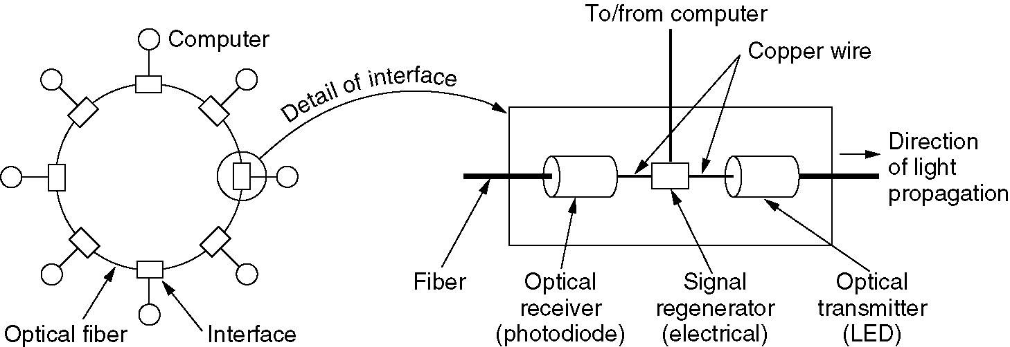
Fiber Optic Networks
A fiber optic ring with active repeaters.

Slide 108
Comparison between Fiber Optics and Copper Wire
Fiber optic
It can handle higher bandwidth than copper
Due to low attenuation repeaters are needed only about every 50 km long line, whereas copper wire every 5 km
Cost saving as less repeaters are needed
Not being affected by electromagnetic interference or power failures. It is not affected by corrosive chemicals
Fibers do not leak light and are quite difficult to tap, excellent security against potentially wire tappers
Thin and light weight
Lower installation cost
Few skilled engineers having fiber technology are available
Fibers can be damaged easily by being bent too much.
Two way communication requires two fibers
Fiber interfaces are costly
Long distance fiber is good choice

Slide 109
Unguided Media
Radio Transmission
Microwave Transmission
Infrared and Millimeter Waves

Slide 110

Wireless transmission waves

Slide 111
Wireless transmission
Radio Transmission
Radio waves are easy to generate, can travel long advances, and can penetrate buildings easily, so they are widely used for communication.
Radio waves are omni directional, meaning that they travel in all directions from the source.
At low frequencies, radio waves power falls off with distance from the source

Slide 112
It provides high data transmission rates.
This wave has a 3KHz to 1GHz frequency range.
Sending and Receiving antennas are not aligned.
It is used for Multicasting.
Mostly used applications are FM radio,Television,Mobiles.

Slide 113
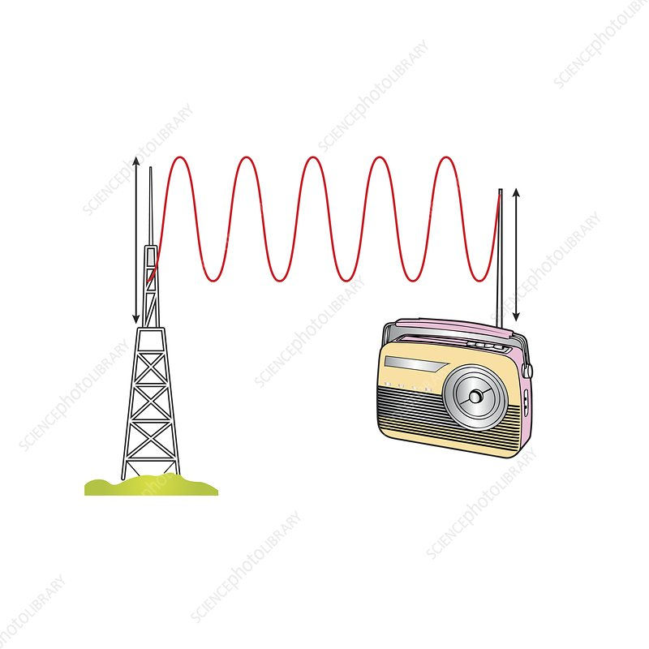

Slide 114
Micro waves :
It uses antennas as the main element for sending and receiving data.
The distance covered by the signal is directly proportional to the height of the antenna.
Range: 1 GHz-300GHz.
They carry large amount of information with capacity.

Slide 115
Satellite microwaves can communicate via any device globally.
Mostly used Applications are Mobiles, Television,Satellite networks.

Slide 116
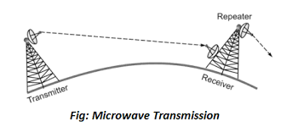

Slide 117
Infrarred Waves:
It is a Wireless technology used for communication over extreamly short distance.
The Range of the frequency is from 300GHZ-400THz.
Data can not pass through the obstacles.
It provides high bandwidth and security.
It holds lower information rate of transmission.

Slide 118
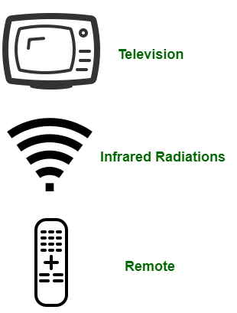

Slide 119
Most used applications are :
TV Remote
Wireless Mouse,Keyboard,Printer,
Transfer data between two Mobiles.

Slide 120
Wireless transmission
Radio waves are used for multicast communications, such as radio and television, and paging systems.
Microwaves are used for uni-cast communication such as cellular telephones, satellite networks and wireless LANs.
Infrared signals can be used for short-range communication in a closed area using line-of-sight propagation.

